Slide 1
Interesting case
Diagnosis : Dental caries
Operation : Full mouth

Slide 2
History
ผู้ป่วยชายไทย อายุ 3 ขวบ 11 เดือน
CC : นัดมาถอนฟัน

Slide 3
History
1 mo PTA ฟันผุทั้งปาก ปวดฟัน กินข้าวได้น้อย ไม่มีไข้ ไม่เหนื่อย วิ่งเล่นได้ปกติ พัฒนาการล่าช้า
คลอด term BW 3.46 kg
แรกคลอดตรวจพบความผิดปกติ ของใบหน้า , ฟังหัวใจได้ยินเสียง murmur
Work up พบ abnormal genetic , Diagnosis : Noonan syndrome

Slide 4
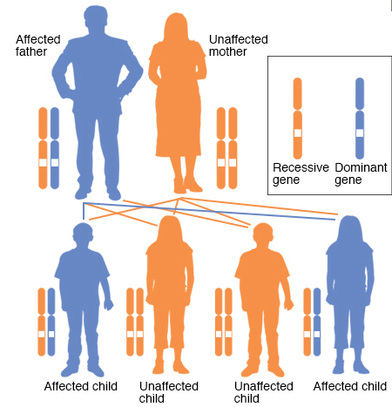
Noonan syndrome
Noonan syndrome is an autosomal dominant genetic disorder caused by abnormalities (mutations) in several different genes
PTPN11, KRAS, SOS1 RIT1 and RAF1
Affect approximately one in 1,000 to one in 2,500 people

Slide 5
Noonan syndrome
Characteristics may be related to the specific gene containing the mutation
Facial features
Heart disease
Growth issues
Musculoskeletal issues
Learning disabilities
Eye conditions
Genital and kidney conditions
Skin conditions
Notes:
โดยจะเกี่ยวกับเราก็มี 2 ระบบ ด้วยกัน

Slide 6
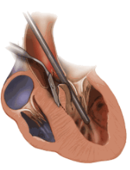
Past History
HOCM s/p myectomy [5/11/2559]
Current medication
Propranolol [10] ½ x 2 oral PC
F/U opd cardio [18/7/60]
Echo : mild to moderate MR , SAM positive , no AR , RVSP 22 mmHg , subvalve AS [PG max 38 , mean 25]

Slide 7
Past History
ไม่มีประวัติแพ้ยา
แพ้ปลาเค็ม กินแล้วหน้าแดงๆ
รับวัคซีนครบตามกำหนด
พัฒนาการช้าทั้งด้านสติปัญญาและร่างกาย
เคยรับการผ่าตัด myectomy under GA [5/11/2559]

Slide 8
R1

Slide 9
Past History
ไม่มีประวัติ URI ใน 2 สัปดาห์ที่ผ่านมา
ผ่าตัดครั้งก่อนไม่ได้มีประวัติใส่ท่อช่วยหายใจลำบาก
ไม่มีประวัติ CHF , syncope , dyspnea
ไม่มีประวัติสำลัก
ไม่มีประวัติ sudden death ในครอบครัว
Notes:
Exertional syncope is associated with an increased risk of sudden death and severity and fatal arrthmia

Slide 10
Physical Examination
A Thai male boy, good consciousness, active, no cyanosis, no dyspnea
V/S : BT 36.7 c , BP 111/67 mmHg PR 102/min , RR 26/min
BW 13.6 kg , HT 86.9 cm

Slide 11
Physical Examination
HEENT :
Large head with a prominent forehead , no macrosomia/microsomia , no hypospastic mandible [micronatria]
Eyes : wide-set eyes , not pale conjunctivae, anicteric sclera
Ears : low set and rotate back ward
Airway : full ROM of neck, Mallampatti can’t be evaluated, missing teeth , can open mouth

Slide 12
Physical Examination
Heart: normal S₁S₂ , pansystolic ejection murmur at apex , regular rate , no heaving
Lung : equal breath sounds Rt = Lt , no adventitious sounds
Abdomen : soft, not tender, normoactive bowel sound
Back : no mass
Genitalia : normal male type
Extremities : normal movement, no deformity , no pitting edema
Neurological : grossly intact

Slide 13
Lab Investigation
CBC : Hb 13.2 g/dl , Hct 38.4 %, Platelet 425000 /mm³
Electrolytes : Na 137, K 3.8, Cl 100, CO₂ 24
BUN/Cr :14.5/0.27 mg/dL

Slide 14
Chest X-ray

Slide 15
R2
Problem lists

Slide 16
Problem lists
A Thai boy Diagnosis dental caries Operation full mouth
U/D Noonan syndrome with HOCM s/p myectomy , vulvular heart disease ,
Delay growth development

Slide 17
Preoperative
Full mouth operation
Operation in mouth >> airway management
Blood and secretion in full mouth operation
Minimal bleeding

Slide 18
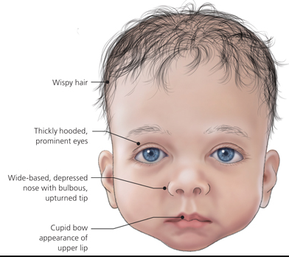
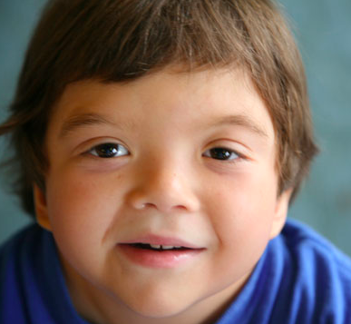
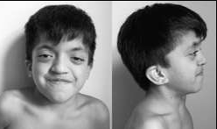
Preoperative
Noonan syndrome
Facial abnormality >> Evaluated for difficult airway

Slide 19
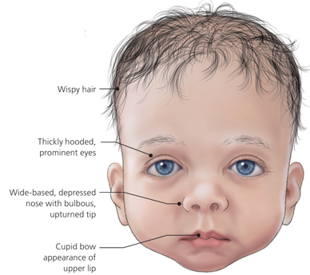
Facial features

Slide 20
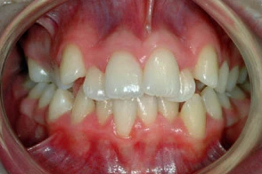
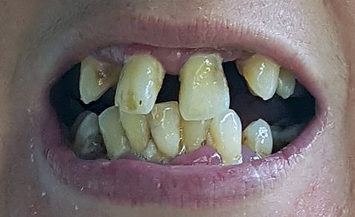
Preoperative
Mouth
Teeth may be crooked

Slide 21
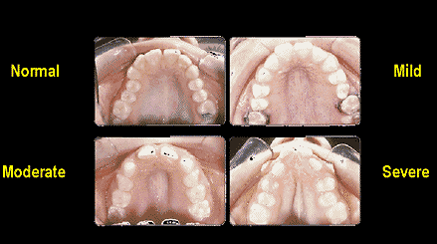
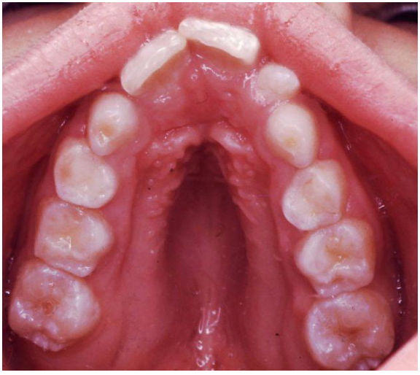
Preoperative
Mouth
Roof of the mouth (palate) may be highly arched

Slide 22
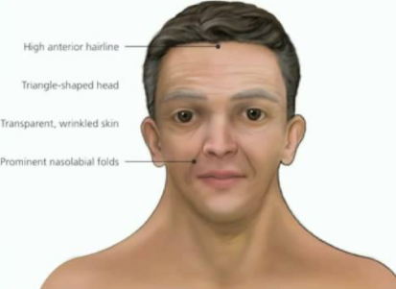
Preoperative
Mouth
Lower jaw may be small

Slide 23
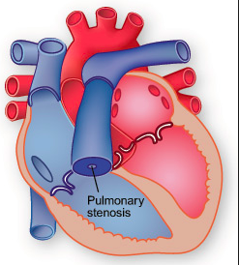
Heart disease

Slide 24
Preoperative
Heart disease
History + physical examination + investigation
Growth development
Nutritional status
Phychological factor affect in family + risk of cardiac complication
Premedication : avoid anxiety induce tachycardia , reduce sympathetic activity , decrease cardiac workload
Update cardiac evaluation

Slide 25
Preoperative
Investigation
Echo : mild to moderate MR , SAM positive , no AR , RVSP 22 mmHg , subvalve AS [PG max 38 , mean 25]

Slide 26
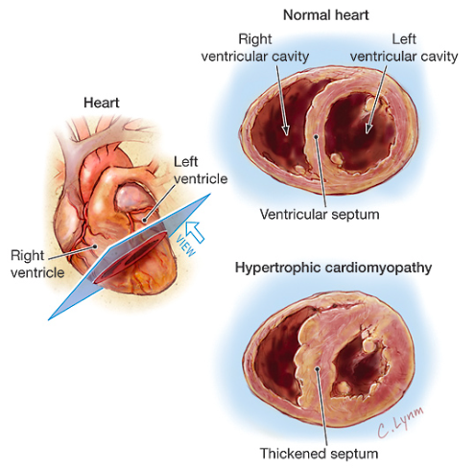
HOCM

Slide 27
HOCM
Notes:
ดังนั้นมันก็จะเป็น vicious cycle วนเวียน แบบนี้

Slide 28
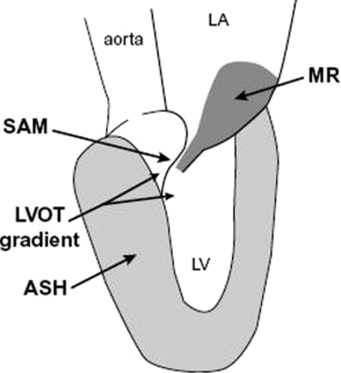
HOCM with SAM

Slide 29
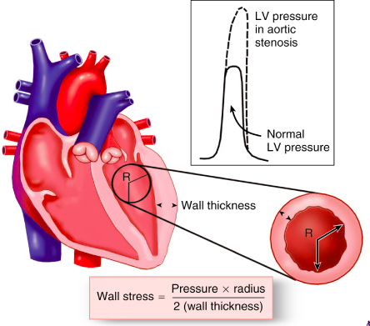
HOCM
Risk of LVOT obstruction
Decrease preload >>

Slide 30
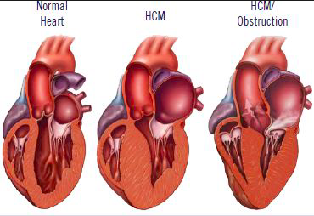
HOCM
Risk of LVOT obstruction
Decrease preload
Increase contractility >>

Slide 31
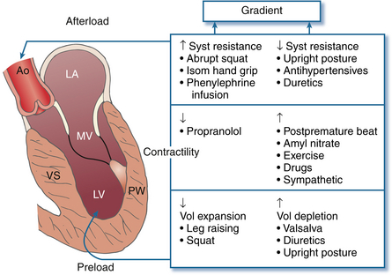
HOCM
Risk of LVOT obstruction
Decrease preload
Increase contractility
Decrease afterload >>

Slide 32
HOCM treatment
Medical
Surgical
Continuous BB until surgery

Slide 33
Preparation
NPO
Inform consent
Premedication
Continuous IV fluid
Anticipated difficult airway
No G/M
Postoperative at ward กุมาร 4
Force air warmer

Slide 34
Preoperative fasting
Notes:
NPO at 03.00 น , clear liquid diet (น้ํา,น้ําแดง) ได้ถึง 6.00

Slide 35
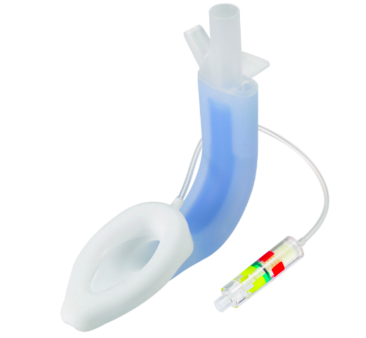
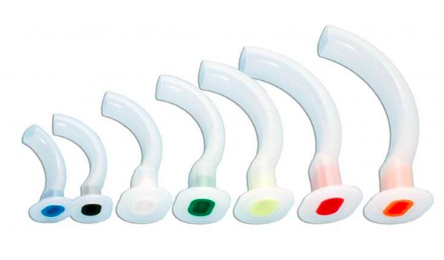
Anticipated difficult airway
Ventilation equipment
Notes:
LMA no 2 เตรียม 1.5 , 2 , 2.5

Slide 36
Anticipated difficult airway
Intubation equipment

Slide 37
Anticipated difficult airway
Oral RAE
Ring, Adair and Elwyn

Slide 38
Intraoperative
Monitoring : Standard , Invasive monitoring
Standard : NIBP , oxygen saturation , EKG , ETCO₂
Invasive : None
Position : supine
Choice of anesthesia : GA with oral RAE with control ventilation
Notes:
ติด external defib ก่อนการ induction

Slide 39
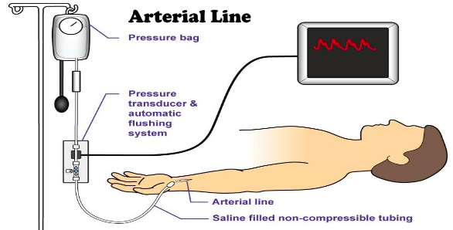
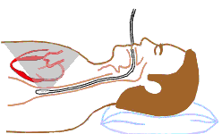
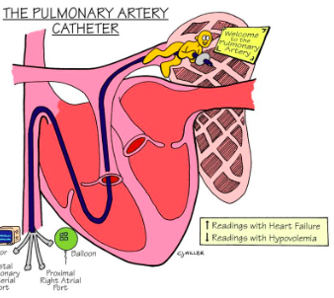
Intraoperative
Invasive Monitoring

Slide 40
R3
Anesthetic consideration

Slide 41
Anesthetic consideration
Difficult airway
Avoid aggravating the subaortic obstruction
Balance oxygen demand and supply
Consideration in pediatric anesthesia

Slide 43
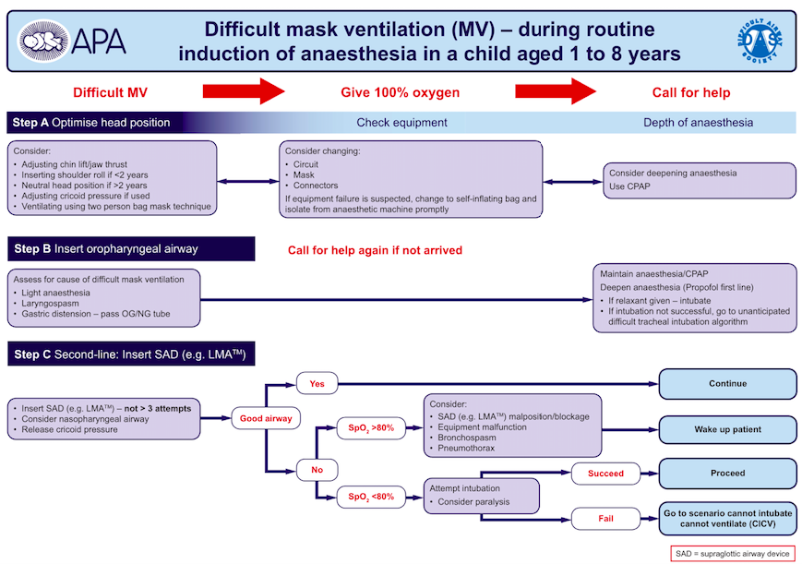

Slide 44
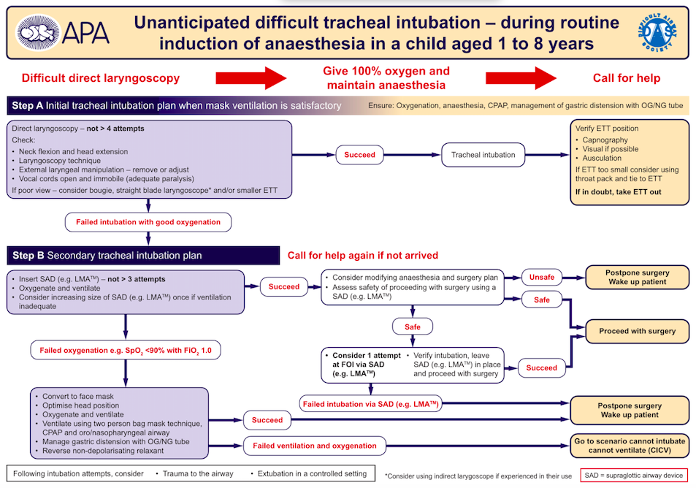

Slide 45
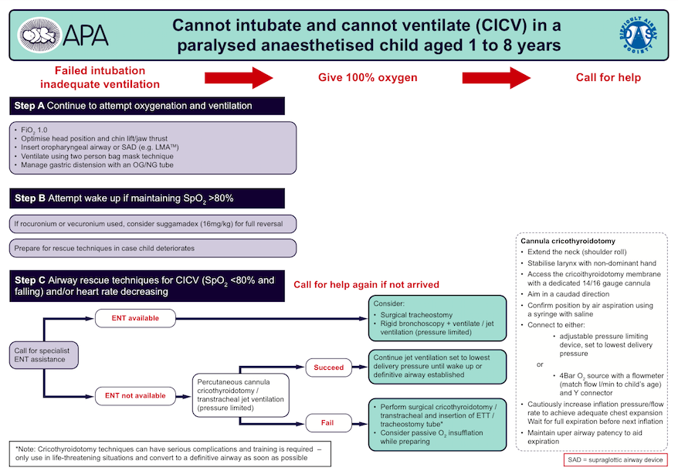

Slide 46
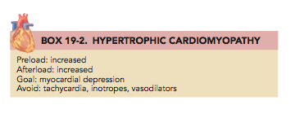
Intraoperative

Slide 47
Intraoperative
Goal
Preload : increased Afterload : increased Contractility : myocardial depression
Avoid : tachycardia ,inotropes ,vasodilators

Slide 48
Intraoperative
Maintain intravascular volume while avoiding direct or reflex increases in contractility or heart rate
Achieved with deep level of GA and associated direct myocardial depression
Agents use
Aim : minimizing decreases in systemic vascular resistance , prevent tachycardia or sympathetic surges

Slide 49
Intraoperative
Appropriate anesthetic agent is the key
IV induction
Muscle relaxant : avoid vagolytic effect and histamine release
Blunt hemodynamic
Opioid : avoid histamine release
Inhalation : commonly use , dose dependent myocardial depression is ideal
Reverse agent : avoid tachycardia

Slide 50
Intraoperative
Contraindication
Inotropes , B-adrenergic agonists, Calcium are all contraindicated
Worsen the systolic obstruction and perpetuatethe hypotension

Slide 51
Intraoperative
Ventilator setting
Aim : minimizing any reduction in venous return
Small tidal volumes ,rapid ventilatory frequencies

Slide 52
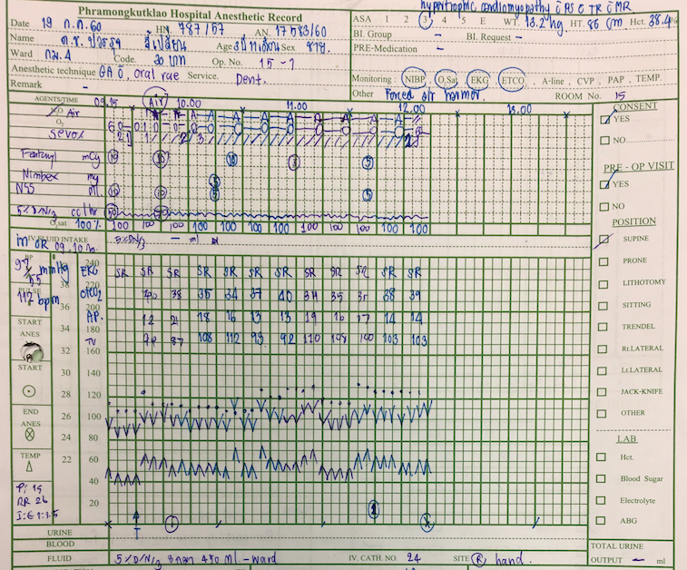
In OR at 9.15
Standard monitoring
Preoxygenation
Premedication : fentanyl 10 mcg , domicum 1 mg
Induction : thiopental 70 mg
Intubation : cis-atracurium 2 mg with oral RAE no. 4.5 with cuff depth 14 cm
Pack gauze prevent secretion
Intake fluid 250 ml
Operation time 3 hr
EBL : minimal

Slide 53
Intraoperative problems
Intraoperative hypotension >> aggressive treatment
Fluid resuscitation
Vasopressor : 1st choice : phenylephrine , 2nd noradrenaline
Avoid inotropic drugs

Slide 54
Intraoperative problems
Intraoperative tachycardia
Light anesthesia
Hypovolemia/Anemia
Vasodilatation
Hypercarbia
Hyperthermia
Hypoxia
Hypotension ???
Cardioversion
IV beta blocker

Slide 55
Intraoperative
Emergence
Awake extubation : avoid tachycardia
Neostigmine 0.5 mg + glycopyrolate 0.1 mg
Transfer with oxygen and recovery position

Slide 56
Postoperative Consideration
Adequate intravascular volume
Avoid tachycardia : adequate pain control , no hypoxia , no hypo/hyperglycemia , no hypercarbia , no anemia , keep normothermia , shivering
Post operative bleeding and aspiration pneumonia
Postoperative nausea vomiting
Postoperative hyperexia

Slide 57
Postoperative day1
S : ผู้ป่วยตื่นดี ไม่มีคลื่นไส้อาเจียน งอแง ปวดบริเวณแผล ไม่มีไข้ ไม่มีเหนื่อย ไม่มีเจ็บแน่นหน้าอก
O : v/s BT 36.8 , BP 100/65 , PR 102 bpm , RR 25
Heart: pulse full and regular , normal S₁S₂ , pansystolic ejection murmur at apex
Lung : clear , equal breath sounds Rt = Lt , no adventitious sounds
Airway : no stridor , no signs of airway obstruction , no active bleeding

Slide 58
Postoperative day1
A : dental caries s/p full mouth operation
P : paracetamol 3 ml oral prn q 4 hr , amoxy 3 ml oral tid PC
Observe bleeding
Observe aspiration and nausea vomitting
Plan D/C tomorrow

Slide 59
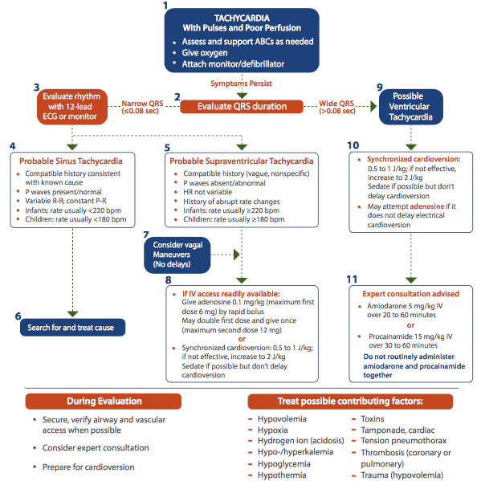

Slide 60
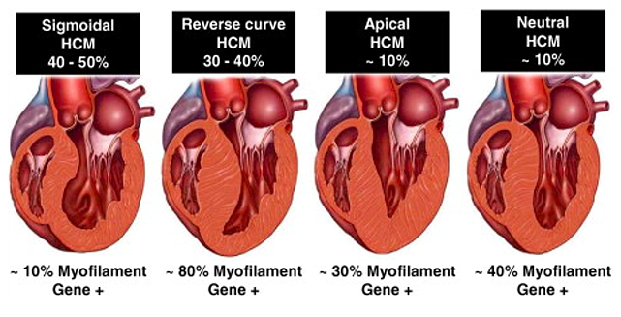

Slide 61
